Slide 1

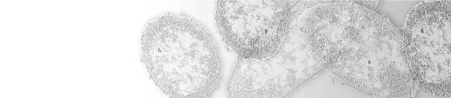
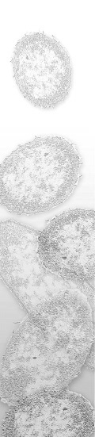
Center for Biofilm Engineering
Statistical methods for analyzing research data
Al Parker, Biostatistician
Standardized Biofilm Methods Research Team
Montana State University
September 29, 2012

Slide 2


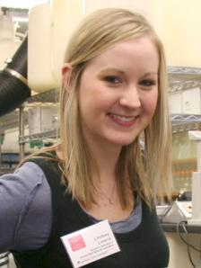
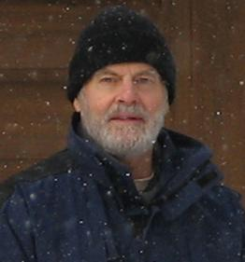

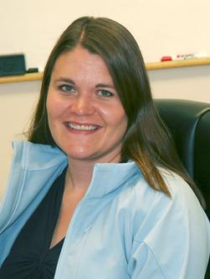

Standardized Biofilm Methods Laboratory
Al Parker
Darla Goeres
Marty Hamilton
Lindsey Lorenz
Diane Walker
Paul Sturman
Kelli Buckingham-Meyer

Slide 3
What is statistical thinking?
Data
Experimental Design
Estimation and variance assessment
Notes:
Once you have chosen a reactor system relevant to your question of interest, it is time for some statistical thinking.

Slide 4
What is statistical thinking?
Data (pixel intensity in an image?
Number of phyla detected by a molecular method?
Length of time to some event? Infected or not?
CFUs from viable plate counts?)
Experimental Design
  - controls (positive and/or negative?)
  - randomization
  - replication (How many repeats in each experiment? Number of experiments? technicians?)
Estimation and variance assessment
- What statistical model to use?
- What summary statistics to report?
Notes:
As microbiology evolves and we move into quantitative methods, performing experiments with control data is of paramount importance.
Type of reactor. How many coupons per reactor experiment. How many experiments? How many technicians? How many labs?

Slide 5
Why statistical thinking?
Anticipate criticism (design method and experiments accordingly)
Provide convincing results (establish statistical properties)
Increase efficiency (conduct the least number of experiments)
Improve communication
Notes:
The application of statistical thinking leads one to anticipate criticism and make necessary adjustments, thereby improving the method. If good statistical characteristics have been established for a method, product efficacy values based on that method will probably be convincing to others. Statistical evaluation of a laboratory method depends on experiments that entail proper control, replication, and randomization. Statistical techniques can be used to find the smallest set of experiments that will achieve a comprehensive evaluation.

Slide 6

Why statistical thinking?
Biofilm Methods
Notes:
Stat man emphasizes that statistical theory is foundational to developing good methods.

Slide 7

Attributes of a Biofilm Method: Seven R’s
Relevance
Reasonableness
Resemblance
Repeatability (intra-laboratory)
Responsiveness
Ruggedness
Reproducibility (inter-laboratory)
Notes:
7

Slide 8
Attributes of a Biofilm Research Method
Relevance
Reasonableness
Resemblance
Repeatability (intra-laboratory)
Responsiveness
Ruggedness
Reproducibility (inter-laboratory)
Notes:
8

Slide 9
Attributes of a Biofilm Research Method
Relevance
Reasonableness
Resemblance
Repeatability (intra-laboratory)
Responsiveness
Ruggedness
Reproducibility (inter-laboratory)
Notes:
9

Slide 10
A standard laboratory method is said to be relevant to a real-world scenario if, given the same inputs, the laboratory outcome is predictive of the real-world outcome.
Relevance

Slide 11
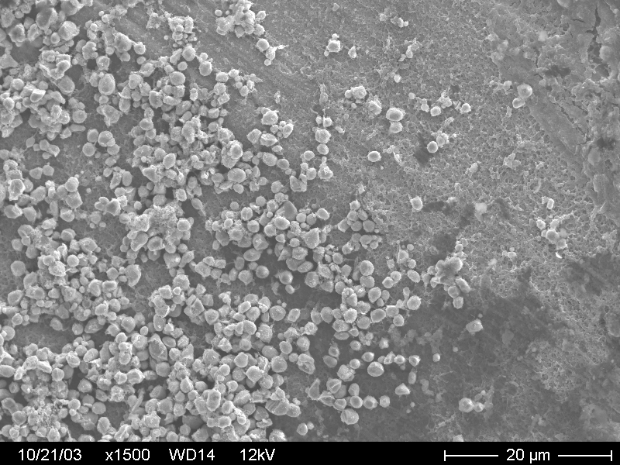
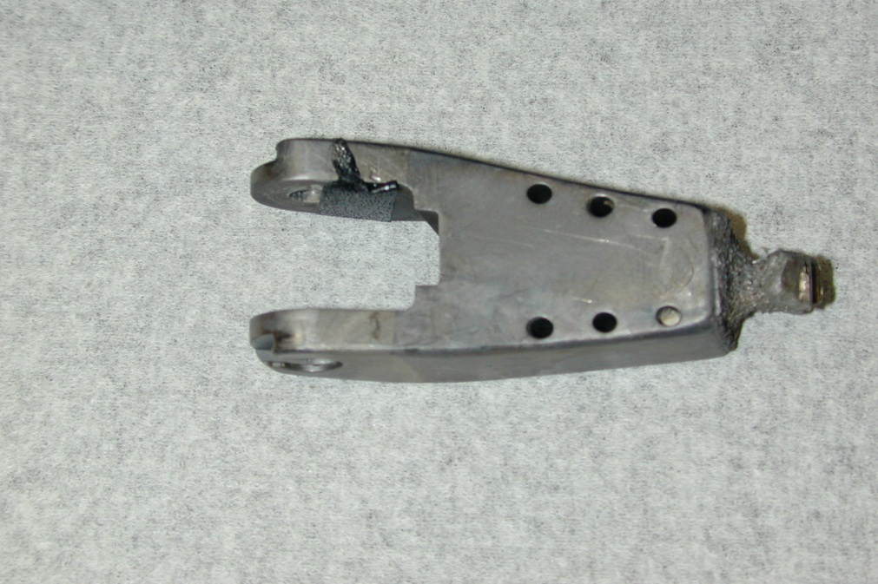
Elbow Prosthesis - in vivo study
Notes:
Infected prosthetic removed from a patient and analyzed at the MBL at the CBE

Slide 12
Urinary catheter in vivo study
Notes:
Removed from patients and analyzed by MBL at CBE

Slide 13
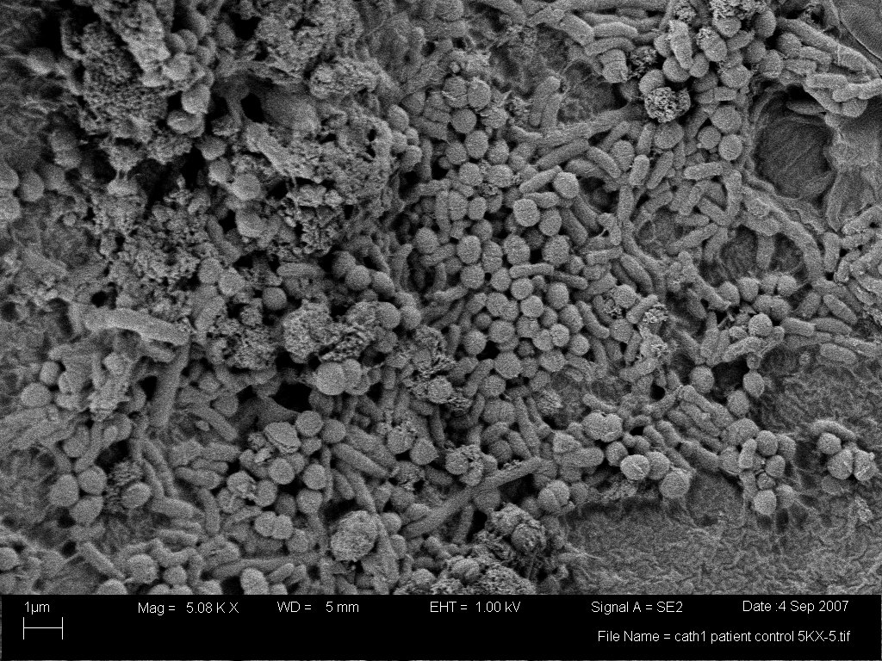
Urinary Catheter Biofilm

Slide 14
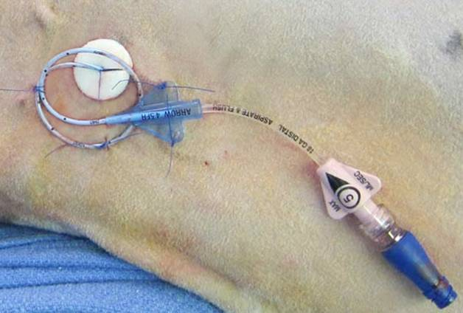
CV Catheter in vivo study
Notes:
Sheep study of central venous catheters

Slide 15
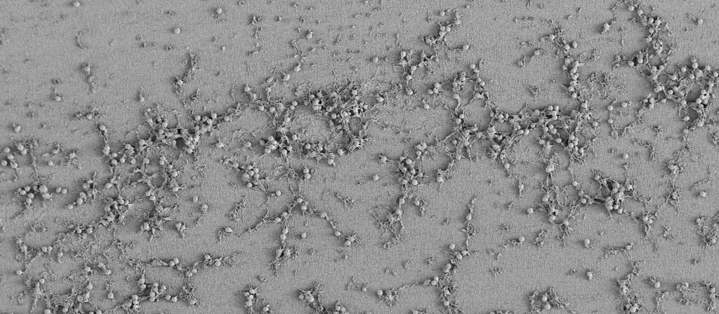
Biofilm in the Catheter Tip
1,000 X magnification
Sheep (control)

Slide 16
Attributes of a Biofilm Research Method
Relevance
Reasonableness
Resemblance
Repeatability (intra-laboratory)
Responsiveness
Ruggedness
Reproducibility (inter-laboratory)
Notes:
16

Slide 17
Resemblance
Independent repeats of the same experiment in the same laboratory produce nearly the same control data, as indicated by a small
repeatability standard deviation,
CS_{r} = STDEV(Mean Controls for each experiment)
http://www.biofilm.montana.edu/content/ksa-sm-10
Notes:
This formula, based on the Method of Moments, gives the same results as the method of restricted maximum likelihood only if the data are balanced and STDEV(Mean Controls for each experiment) > pooled(within experiment)/(number of coupons in each experiment).

Slide 18
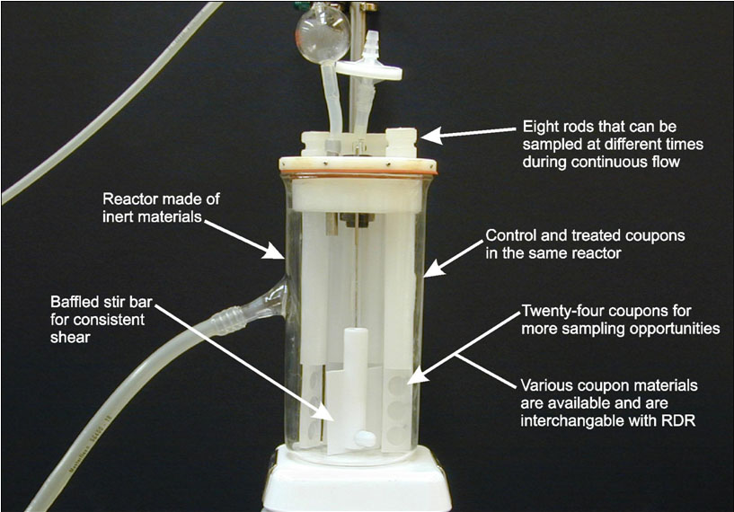
Resemblance Example

Slide 19
Resemblance Example
Data: log₁₀(cfu) from viable plate counts
Coupon Density LD
cfu / cm² log(cfu/cm²)
1 5.5 x 10⁶ 6.74
2 6.6 x 10⁶ 6.82
3 8.7 x 10⁶ 6.94
Mean LD= 6.83
Notes:
Take log transforms! Then calculate all statistics on the log scale.

Slide 20
Resemblance Example
Exp | coupon LD |  | Control LD |  |  | SD
1 | 6.73849
1 | 6.82056 |  | 6.83240 |  |  | 0.10036
1 | 6.93816
2 | 6.56276
2 | 6.63957 |  | 6.61440 |  |  | 0.04472
2 | 6.64086
3 | 6.91564
3 | 6.74557 |  | 6.85293 |  |  | 0.09341
3 | 6.89758
Notes:
Take log transforms! Then calculate all statistics on the log scale.

Slide 21
Resemblance from experiment to experiment
Summary Statistics:
1. Mean ControlLD = 6.77
the best guess for the
true mean control LD
2. CS_{r} = 0.1322,
the typical distance between
the ControlLD for a
single experiment and the
true mean control LD
log₁₀ (cfu/cm²)
CS_{r} = STDEV(6.83240, 6.61440, 6.85293)
not STDEV(LDs)
Notes:
Since S_{r} = .15, these data indicate good resemblance of the control data from experiment to experiment.

Slide 22
Resemblance from experiment to experiment
The variance
CS_{r}² = 0.1322²
can be partitioned:
87% due to among
experiment sources
13% due to within experiment sources
log₁₀ (cfu/cm²)
Variance partitioned by:
0.87 = AVG(control SDs²)/(n_{c} x0.1322²)
0.13 = 1 - 0.87

Slide 23
Convincing others that you can estimate true mean control LD with confidence
1. Start with your best guess: Mean ControlLD
2. Calculate the SE of Mean ControlLD, using:
CS_{r} = the repeatability SD
m = number of experiments
SE of Mean ControlLD = CS_{r} /
m
3. CI for the true mean control LD = Mean ControlLD ± t_{df=m-1} x SE
Notes:
SE is the SD of a statistic.

Slide 24
Convincing others that you can estimate true mean control LD with confidence
1. Mean ControlLD = 6.77
2. SE of Mean ControlLD = CS_{r} / = 0.1322/ = 0.0763
m
3
3. A 95% CI for true mean control LD = Mean ControlLD ± t_{df=2} x SE
= 6.77 ± 4.30 x 0.0763
= 6.77 ± 0.3284
= (6.44, 7.09)
Notes:
With df = m - 1 = 2, the multiplier = 4.30. With only 2 experiments, get a multiplier of 12.7. Need 60 experiments to get multiplier = 2.

Slide 25
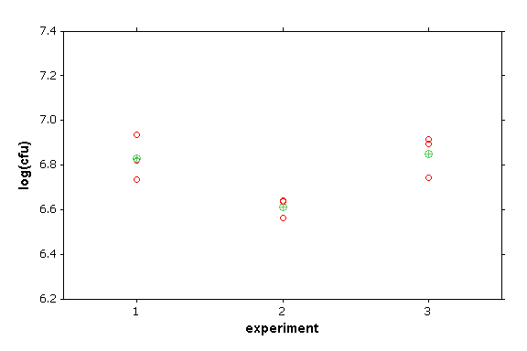
Convincing others that you can estimate true mean control LD with confidence
We are 95% confident that the true mean of the control LDs is between
6.44 and 7.09
log₁₀ (cfu/cm²)

Slide 26
Resemblance from technician to technician
Summary Statistics:
1. Mean LD = 8.42
the best guess for the
true mean control LD
2. CS_{r} = 0.17
the typical distance between
the ControlLD for a
single experiment for a single tech and the
true mean control LD
across multiple techs
log₁₀ (cfu/cm²)

Slide 27
Resemblance from technician to technician
The variance CS_{r}² = 0.17²
can be partitioned:
39% due to technician sources
43% due to between experiment sources
18% due to within experiment sources
log₁₀ (cfu/cm²)
Variance partitioned by ANOVA

Slide 28
Attributes of a Biofilm Research Method
Relevance
Reasonableness
Resemblance
Repeatability (intra-laboratory)
Responsiveness
Ruggedness
Reproducibility (inter-laboratory)
Notes:
28

Slide 29
Repeatability
Independent repeats of the same experiment in the same laboratory produce nearly the same response, as indicated by a small
repeatability standard deviation
S_{r} = STDEV(Mean response for each experiment)
http://www.biofilm.montana.edu/content/ksa-sm-10
Notes:
The formula for the repeatability SD is based on MOM and agrees with REML only if the data are balanced and STDEV(Mean response for each experiment) > pooled(within-experiment response SD)/(number of responses in each experiment).

Slide 30
Repeatability Example
Data: log reduction (LR)
LR = mean(control LDs) – mean(disinfected LDs)
You should analyze LRs instead of the individual
control and treated LDs because usually the
controls and treated exhibit different variability,
which violates the homogeneity of variance assumption of the ANOVA model.

Slide 31
Repeatability Example
Exp | coupon LD |  | Control LD |  |  | SD
1 | 6.73849
1 | 6.82056 |  | 6.83240 |  |  | 0.10036
1 | 6.93816
2 | 6.56276
2 | 6.63957 |  | 6.61440 |  |  | 0.04473
2 | 6.64086
3 | 6.91564
3 | 6.74557 |  | 6.85293 |  |  | 0.09341
3 | 6.89758

Slide 32
Repeatability Example
 | log density
Exp | control | treated |  | Control LD | Treated LD |  | LR
1 | 6.73849 | 3.08115
1 | 6.82056 | 3.29326 |  | 6.83240 | 3.13546 |  | 3.69695
1 | 6.93816 | 3.03196
2 | 6.56276 | 2.92334
2 | 6.63957 | 3.03488 |  | 6.61440 | 3.05656 |  | 3.55784
2 | 6.64086 | 3.21146
3 | 6.91564 | 2.73748
3 | 6.74557 | 2.66018 |  | 6.85293 | 2.70805 |  | 4.14487
3 | 6.89758 | 2.72651
Since there is no obvious pairing between the controls and treated coupons in each experiment, get 1 LR for each experiment
Mean LR = 3.80

Slide 33
Repeatability Example
Summary Statistics:
1. Mean LR = 3.80
the best guess for the
true mean LR
2. S_{r} = STDEV(LRs)
= 0.3068
the typical distance between
the LR for a
single experiment and the true mean LR
Notes:
LR are more variable than the controls!

Slide 34
Convincing others that you can estimate true mean LR with confidence
1. Start with your best guess: Mean LR
2. Calculate the SE of Mean LR, using:
S²_{c} = within-experiment variance of control coupon LD = AVG(control SDs²)
S²_{d} = within-experiment variance of treated coupon LD = AVG(treated SDs²)
S²_{E} = among-experiment variance of LR = S²_{r} - [S²_{c} / n_{c} + S²_{d} / n_{d}]
n_{c} = number of control coupons per experiment
n_{d} = number of treated coupons per experiment
m = number of experiments
S
2
S
2
S
2
SE of mean LR = S_{r} / =
c
d
E
+
+
m
n_{c} • m
n_{d} • m
m
3. CI for the true mean LR = Mean LR ± t_{df=m-1} x SE
Notes:
SE is the SD of a statistic. The df is calculated incorrectly for many software packages!

Slide 35
Convincing others that you can estimate true mean LR with confidence
1. Mean LR = 3.80
2. S_{c}² = AVERAGE(0.10036²,0.04472²,0.09341²) = 0.00693
S_{d}² = AVERAGE(0.13886²,0.14528²,0.04182²) = 0.01405
S_{E}² = 0.3068² - [0.00693/3 + 0.01405/3] = 0.08711
n_{c} = 3, n_{d} = 3, m = 3
0.00693
0.01405
0.08711
SE of mean LR = 0.3068 / =
+
+
= 0.1771
3
3 • 3
3 • 3
3
3. 95% CI for true mean LR = 3.80 ± 4.30 x 0.1771
= 3.80 ± 0.7616
= (3.04, 4.56)

Slide 36
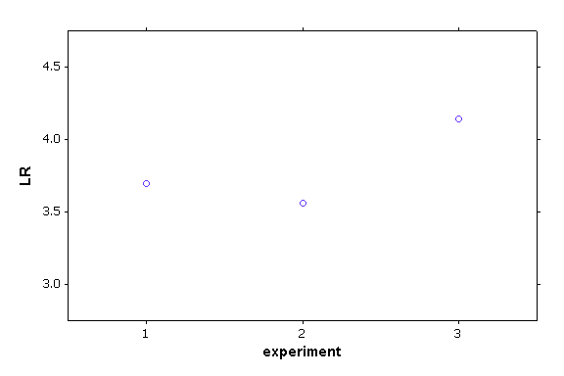
Convincing others that you can estimate true mean LR with confidence
We are 95% confident that the true mean LR is between
3.04 and 4.56
The mean LR is statistically significantly larger than 3
((p-value=0.0228) using an upper 1-sided t-test with df=2)

Slide 37
How many coupons? experiments?
.00693
.01405
.08771
margin of error= t_{m-1} x 0.3068/ = t_{m-1} x
+
+
m
n_{c} • m
n_{d} • m
m
no. control coupons (n_{c}): | 2 | 3 | 5 | 12
no. treated coupons (n_{d}): | 2 | 3 | 5 | 12
no. experiments (m)
2 | 2.81 | 2.76 | 2.71 | 2.68
3 | 0.78 | 0.76 | 0.75 | 0.74
4 | 0.50 | 0.49 | 0.48 | 0.47
6 | 0.33 | 0.32 | 0.32 | 0.31
10 | 0.22 | 0.22 | 0.22 | 0.21
100 | 0.06 | 0.06 | 0.06 | 0.06
Notes:
Increasing the number of experiments will decrease the SE of the LR more than increasing the number of coupons! However, it is more expensive to perform more experiments, so the trade-off is cost vs precision of the statistics.

Slide 38
Attributes of a Biofilm Research Method
Relevance
Reasonableness
Resemblance
Repeatability (intra-laboratory)
Responsiveness
Ruggedness
Reproducibility (inter-laboratory)
Notes:
38

Slide 39

Responsiveness
A method should be sensitive enough that it can detect important changes in parameters of interest.
Statistical tool: mixed effects regression or ANOVA (e.g., repeated measures regression or ANOVA)

Slide 40
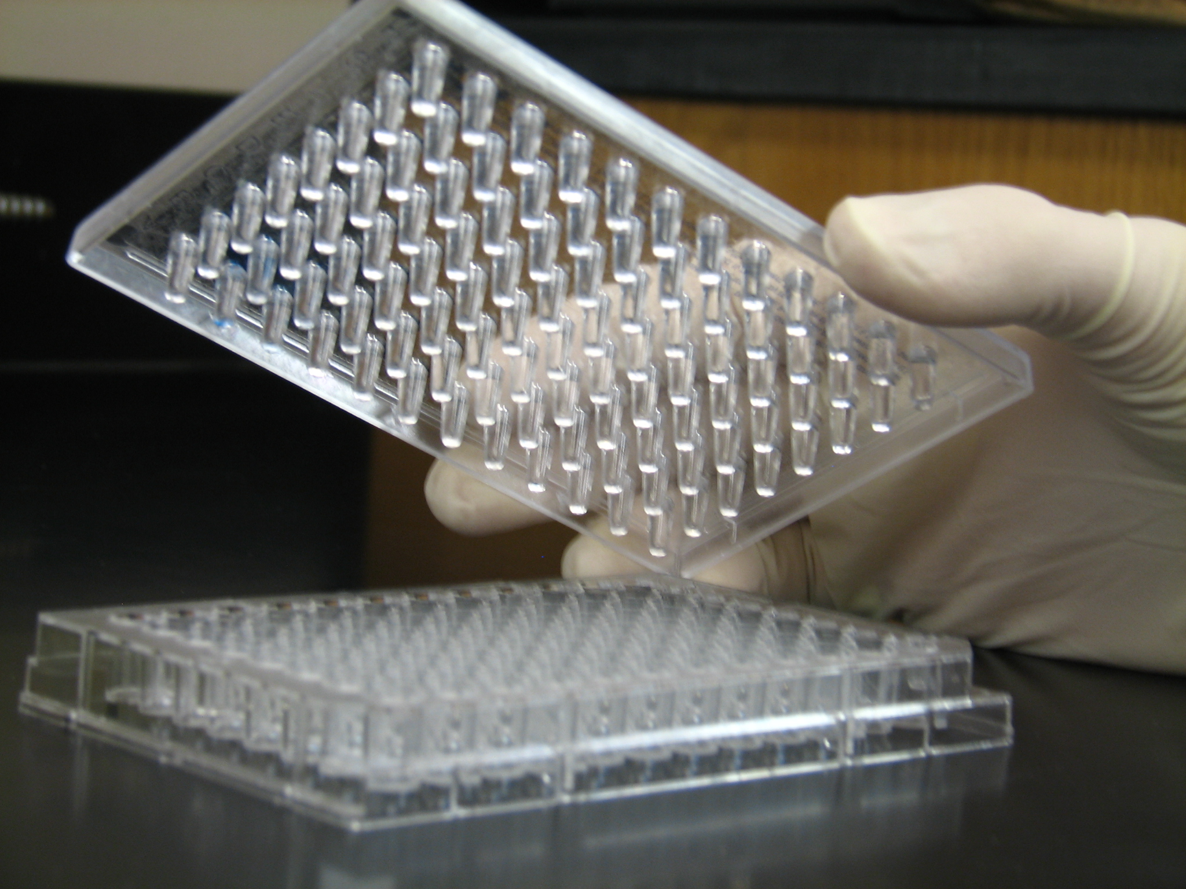
Responsiveness Example

Slide 41
Responsiveness: to changes in treatment concentration
LR = -0.4513 + .9389*DisConc
This dose-response curve can be simply
(but not exactly) represented by a line
Stat Model: repeated measures (within each experiment) regression with disinfectant concentration as the covariate
Notes:
Data from 4 experiments of biofilms grown in the MBEC using the ASTM standard and then treated with different concentrations of Virkon, a non-chlorine oxidizer.

Slide 42
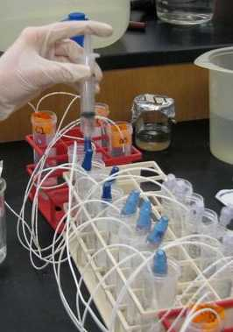
Responsiveness Example
Notes:
Biofilms grown in hubs via protocol generated in Garth James lab in a needleless connector study described in Poster: "Evaluation of Fluid Path Colonization in NeedleFree Connectors and Biofilm Formation in Central Venous Catheters." Elinor deLancey Pulcini, Al Parker, Marcia Ryder, Alison Burcar, Garth James. ASM Biofilm Meeting, Miami, September, 2012.

Slide 43
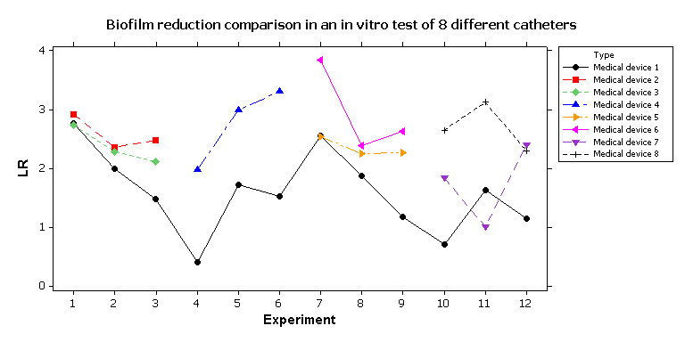
Responsiveness: to different treatments
Comparing mean LRs in side-by-tests

Slide 44
Responsiveness: to different treatments
Medical Device Efficacy
Medical Device | Mean LR | Significant Groups
1 | 1.599 | A
7 | 1.749 | A | B
3 | 2.303 | A | B | C
5 | 2.368 | A | B | C | D
2 | 2.519 |  | B | C | D | E
6 | 3.067 |  |  | C |  | E | F
8 | 2.690 |  |  |  | D | E | F
4 | 2.915 |  |  |  | D |  | F
P-values
 | 1 | 7 | 3 | 5 | 2 | 6
7 | 0.9587
3 | 0.4307 | 0.9994
5 | 0.2477 | 0.8796 | 0.9950
2 | 0.0154 | 0.8835 | 0.2933 | 1.000
6 | 0.0065 | 0.0049 | 0.0550 | 0.0002 | 0.3297
8 | 0.0002 | 0.0001 | 0.0132 | 0.1401 | 0.1467 | 1.000
4 | 0.0004 | 0.0003 | 0.0018 | 0.0869 | 0.0193 | 0.9992
Comparing mean LRs in side-by-tests
Stat Model: repeated measures (within each experiment) ANOVA with fixed effect due to type of medical device

Slide 45
Summary
Good experiments use controls, randomization where possible, and
sufficient replication.
Even though biofilms are complicated, it is feasible to develop biofilm
methods that meet the “Seven R” criteria:
- Assess Resemblance by repeatability SD of the controls.
- Assess Repeatability by repeatability SD of the response of interest.
Estimate parameters of interest and assess variance by reporting CIs.
To reduce variance in estimates, invest effort in conducting more
experiments instead of using more repeats in each experiment.
For data analysis across multiple experiments, use mixed effects models
(i.e., models that account for repeated measures from each experiment)
For additional statistical resources for biofilm methods, check out:
http://www.biofilm.montana.edu/category/documents/ksa-sm

Slide 46
Any questions?

