Slide 1
Center for Biofilm Engineering
Using equivalence testing in microbiology
Albert Parker
Biostatistician and Research Engineer
Center for Biofilm Engineering, MSU
July 2011

Slide 2
Standardized Biofilm Methods Laboratory
Diane Walker
Paul Sturman
Lindsey Lorenz
Kelli Buckingham-Meyer
Marty Hamilton
Darla Goeres

Slide 3
Outline
What is an equivalence test?
Equivalence vs. significance
How to perform an equivalence test?
Example: Neutralization tests

Slide 4
What is an equivalence test?
When comparing two methods, treatments, inocula, medical devices, etc:
An equivalence test is a statistical method used to seek an answer to the question:
“Are the treatments the same?”
This is very different than the question answered by traditional significance tests:
“Is there a difference in treatments?”
Notes:
Equivalence test hypotheses are “backwards” from significance test hypotheses.

Slide 5
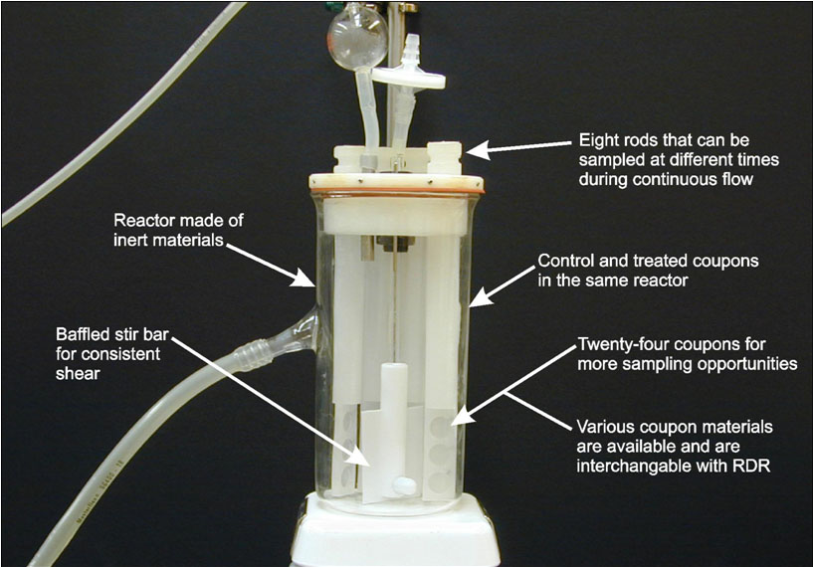
How to perform a significance test?
To test whether two treatments are different:
1. Collect data.
Treatment | LD | Mean
1 | 3.10
 | 3.85
 | 3.35 | 3.77
 | 4.28
 | 4.26
 | 3.42
 | 3.70
2 | 3.57 | 3.60
 | 3.73
 | 3.59
Notes:
This is the scientific method

Slide 6
How to perform a significance test?
To test whether two treatments are different:
Calculate a p-value for the difference in means.
Treatment | LD | Mean
1 | 3.10
 | 3.85
 | 3.35 | 3.77
 | 4.28
 | 4.26
 | 3.42
 | 3.70
2 | 3.57 | 3.60
 | 3.73
 | 3.59
t-test
p-value
0.442

Slide 7
How to perform a significance test?
To test whether two treatments are different:
3. If p-value <0.05, then conclude:
“The evidence suggests that there is a
difference on the average between the two treatments”
OR: if p-value > 0.05 (in this case, p-value = 0.442), then conclude:
“The evidence fails to suggest that there is
a difference on the average between the two treatments”
Notes:
The researcher chooses the level of significance, or the amount of evidence, in order to conclude the difference.

Slide 8
How to perform an equivalence test?
To test whether two treatments are equivalent:
The researcher specifies an equivalence level ∆, so that mean differences of the two treatments less than ∆ are considered negligible or not of practical importance.
For example, when working with log(CFU), a researcher may consider any mean differences less than ∆ = 0.5 to be negligible
Notes:
Just as the researcher chooses the significance level (of say 0.05), the researcher also chooses the equivalence level. We have used the value of 0.5 at the CBE.

Slide 9
How to perform an equivalence test?
To test whether two treatments are equivalent:
2. Collect data.
Treatment | LD | Mean
1 | 3.10
 | 3.85
 | 3.35 | 3.77
 | 4.28
 | 4.26
 | 3.42
 | 3.70
2 | 3.57 | 3.60
 | 3.73
 | 3.59

Slide 10
How to perform an equivalence test?
To test whether two treatments are equivalent:
3. Calculate a 90% confidence interval (CI) for the difference in means.
Treatment | LD | Mean
1 | 3.10
 | 3.85
 | 3.35 | 3.77
 | 4.28
 | 4.26
 | 3.42
 | 3.70
2 | 3.57 | 3.60
 | 3.73
 | 3.59
t-test
90% CI Mean 1 – Mean 2
(-0.254, 0.491)
Notes:
Subtract the mean for the second treatment from the mean for the first treatment. CI conclusion: The data gives us confidence that the true mean difference is between -.254 and .491.

Slide 11
How to perform an equivalence test?
To test whether two treatments are equivalent:
4. If the 90% CI falls entirely within the
equivalence zone [-∆, ∆]
90% CI Mean 1 – Mean 2
(-0.254, 0.491)
-0.50
-0.25
0.00
0.25
0.50
then conclude:
“The evidence suggests that the two treatments are statistically equivalent
on the average”

Slide 12
Equivalence vs. Insignificance
Equivalence test conclusion:
“the data provide evidence for
statistical equivalence”
Significance test conclusion:
“the data fail to provide evidence that
there is a difference”
Notes:
The first conclusion is stronger! Absense of evidence that there is a difference is not evidence that there is no difference.

Slide 13
Applications in Microbiology
FDA submissions claiming equivalence between
drugs or medical devices.
Verification of an equivalent inoculum or
bio-challenge among different experiments
Neutralization tests
Notes:
The idea of equivalence testing has been developed and promoted by the FDA and pharmaceutical companies (e.g. 510k submissions for medical devices).
We use equivalence tests at the CBE for checking equivalence of inocula across mutliple methods or experiments.
We all do neutralization tests.

Slide 14
Example: Neutralization Testing
Questions:
Is a purported neutralizer inhibitory or
toxic to the bacterial cells?
Does a purported neutralizer inactivate the
anti-microbial activity of a disinfectant?

Slide 15
Example: Neutralization Testing
ASTM E 1054-08
“Standard Test Methods for Evaluation of Inactivators of Antimicrobial Agents”:
Add a neutralizer or DI water, bacterial cells, and disinfectant to 4 test flasks:
A: neutralizer + cells + disinfectant
B: neutralizer + cells
C: DI water + cells
D: disinfectant + cells
Notes:
ASTM: American Society for Testing and Materials.
DI: deionized
Not only does ASTM 1054-8 specify the experimental design, but it also specifies that significance tests be used.

Slide 16
Neutralization: Experimental Design
Replicate #1
Replicate #2
Replicate #3
A
A
A
Sample
Sample
Sample
Grow
Grow
Grow
B
B
B
Sample
Sample
Sample
C
C
C
Sample
Sample
Sample
D
D
D
Sample
Sample
Sample

Slide 17
Example: Neutralization Testing
To determine if a neutralizer PASSES the test:
Is a purported neutralizer inhibitory or
toxic to the bacterial cells?
Compare beaker B to beaker C
Does a purported neutralizer inactivate the
anti-microbial activity of a disinfectant?
Compare beaker A to beaker C

Slide 18
Example: Neutralization Testing
Consider the scenario where we are trying to find a single neutralizer for four different treatments.
We will apply:
Equivalence tests using ∆ = 0.35:
a neutralizer PASSES if a 90% CI is contained in [-0.35, 0.35].
Significance tests using p-value threshold of 0.05: a neutralizer PASSES if a p-value > 0.05.
Notes:
At the CBE, some researchers have specified that mean log density differences up to ∆ = 0.35 are to be considered negligible.

Slide 19
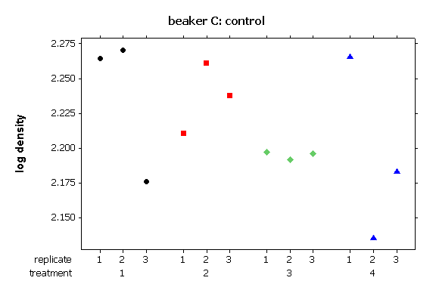
Data: controls
A=neutralizeddisinfectant
C=control
Notes:
Bes sure to explain hor. and vert. axes.

Slide 20
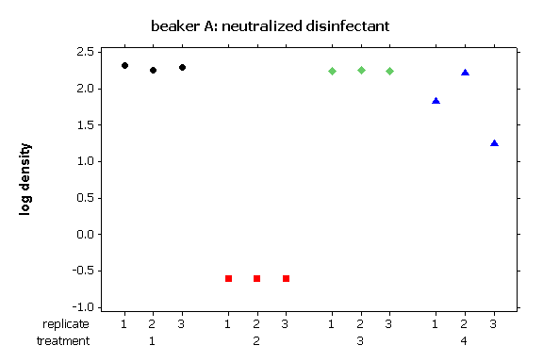
Data: neutralized disinfectant
A=neutralizeddisinfectant
C=control

Slide 21
Does the neutralizer neutralize?
Calculate: a log reduction
LR = log(C) – log(A)
LR =
-

Slide 22
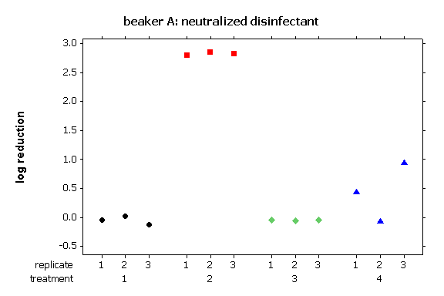
Does the neutralizer neutralize?
LR =

Slide 23
Does the neutralizer neutralize?
Equivalence zone
[-0.35, 0.35]
I
0.297 0.000 0.006 0.281
90% CIs
and p-values
I
The equivalence tests and significance tests agree for the first two scenarios …
I
I
P
F
?
?
Notes:
This example underscores the importance of looking at the data.
Think about this picture for a moment: does the picture of the data suggest that the neutralizer neutralizes? (i.e. that there is a difference on the average between the controls and the cells subjected to the neutalized disinfectant?)

Slide 24
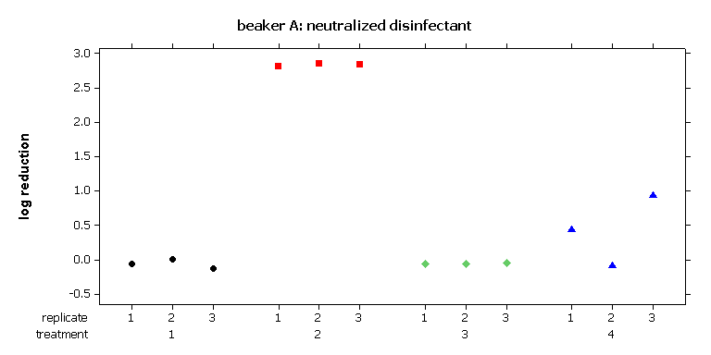
Does the neutralizer neutralize?
 | Treatment 1 | Treatment 2 | Treatment 3 | Treatment 4
Equivalence | P | F | P | F
Significance | P | F | F | P
Concordance
Even though there is a significant difference, the equivalence test indicates it is not of practical importance
I
0.297 0.000 0.006 0.281
I
I
I
P
F
?
?

Slide 25
Does the neutralizer neutralize?
 | Treatment 1 | Treatment 2 | Treatment 3 | Treatment 4
Equivalence | P | F | P | F
Significance | P | F | F | P
The equivalence test fails the neutralizer due to the exceptionally large variability in the data
I
0.297 0.000 0.006 0.281
I
I
P
F
?
?
Notes:
Equivalence tests corroborate intuition by penalizing highly variable experimental outcomes. Significance tests pass a neutralizer because of the highly variable outcome!
Is this a difficult disinfectant to work with, or was a sloppy experiment run?

Slide 26
Equivalence vs. Significance
 |  | Equivalence testing
 |  | failure to suggest equivalence | statistical equivalence
Significance testing | failure to suggest a difference | excess variability in the data | concordance
 | significant difference | concordance | difference not of practical importance

Slide 27
Summary
Equivalence tests are the appropriate statistical tool to use to
provide convincing evidence for conclusions of equivalence.
Equivalence tests are straightforward to use
(via confidence intervals).
There are many applications of interest to microbiologists:
FDA submissions claiming equivalence between drugs or
medical devices
Verification of equivalent inocula among different
experiments and methods or treatments
Neutralization tests

Slide 28
Reference
How to:
Richter, S.J., and Richter, C. (2002) A method for determining equivalence in industrial applications. Quality Engineering 14, 375–380.
Application to a microbiological data:
Tomasino, S.F., & Hamilton, M.A. (2006) Modification to the AOAC Sporicidal Activity of Disinfectants Test (Method 966.04): Collaborative Study. JAOAC Int. 89, 1373–1397.

Slide 29
equivalence testing

